Slide 1
CSE 12: Week 1 Discussion
10-06-2020
Focus: Computer Setup, Zoom, Logistics

Slide 2
Who Am I
Contact Information
Email:
rkreitin@eng.ucsd.edu
Office Hours:
Fri. 11am - 1pm PST
Zoom link: https://ucsd.zoom.us/my/rkreitin
Rebecca Kreitinger,
BS Computer Engineering from University of New Mexico
Current 2nd year Master’s student

Slide 3
What will Discussion cover?
Discussion is broken up into two parts
PA Video (~30 mins): released with the PA to provide an overview as well as related examples/notes
Live Discussion (~20 mins): prepared material to cover helpful topics as well as a time for open questions
The live discussion is NOT meant for questions about how to start the PA that is due the next day.
You may ask conceptual questions about the PA and clarification questions, however, out of respect for your peers refrain from asking specific questions about your own code.
The live discussion will include interactive aspects so that you can do knowledge checks.

Slide 4
Any course related questions?
Programming Assignments will be released on Thursday morning and are due the following Wednesday at 11:59 PM
PA1 released yesterday, due next Wednesday, Oct 14th @ 11:59 PM
Resources:
Optional ZyBook
Tutor hours
Professor/TA office hours

Slide 5
Setup
Starter code - download from Github and unzip the files: https://github.com/CSE12-F20-Assignments/cse12-fa20-pa1-Testing-starter
Starter code is formatted to be easy to open in Eclipse, you also have the option to use the command line.

Slide 6
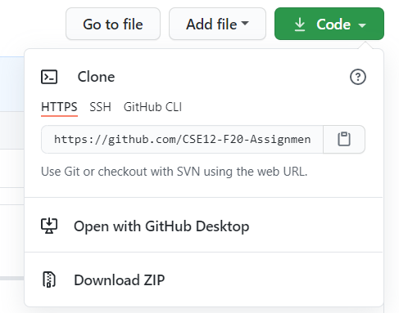
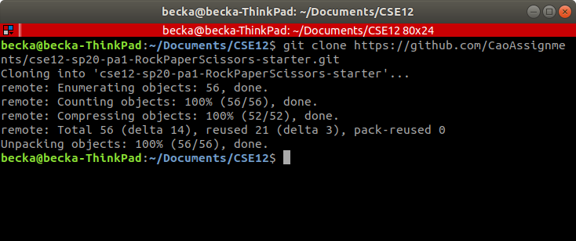
Getting the Starter Code for PAs
Writeup will have a link to the starter code GitHub repository
Two ways to get the code:
From the command line, use git clone <https link>
Download the code as a zip file

Slide 7
Zoom

Slide 8

Downloading Desktop App
Link to download: https://zoom.us/download
Other options:
Zoom web page
Phone or tablet app
Phone call

Slide 9
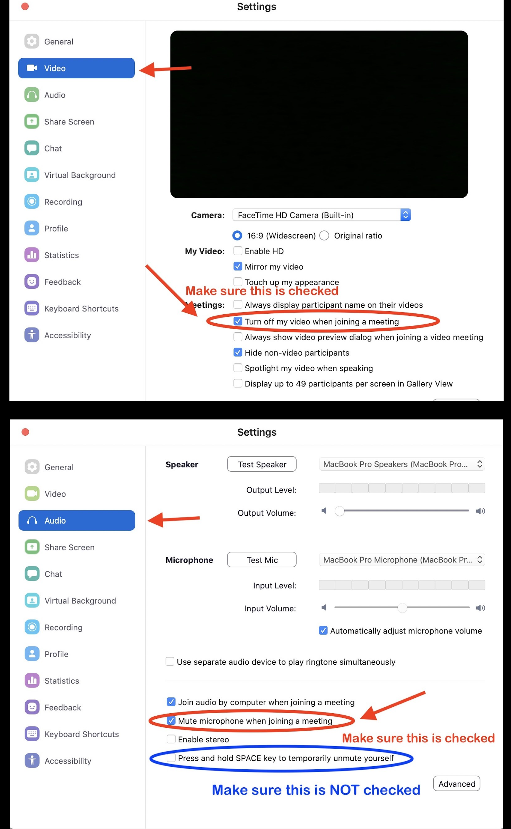
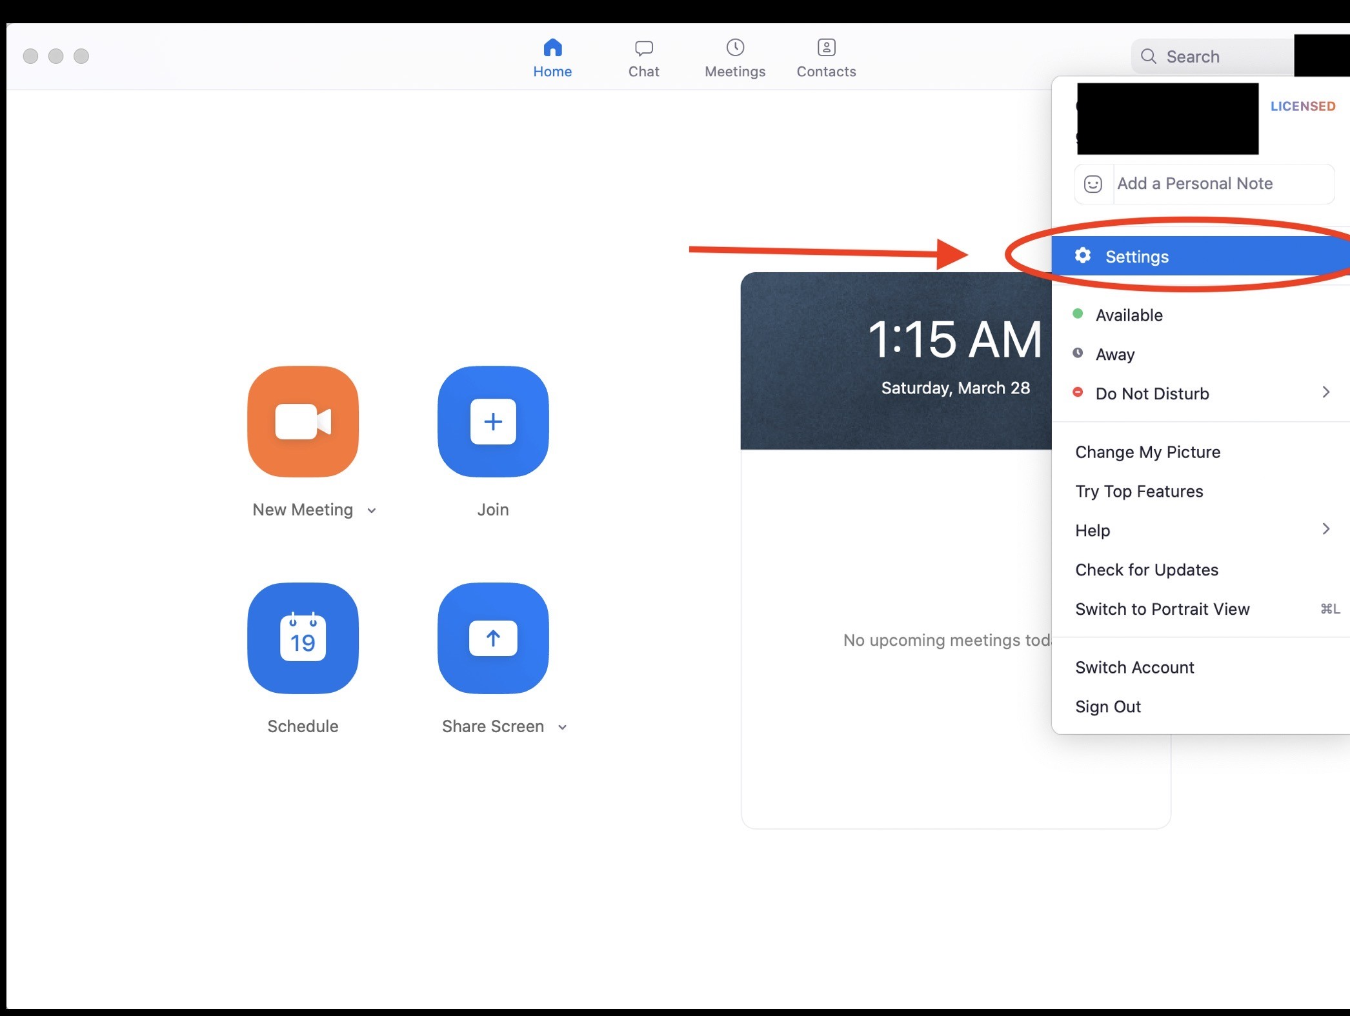
Recommended Setting

Slide 10
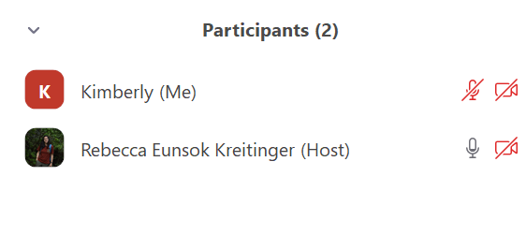
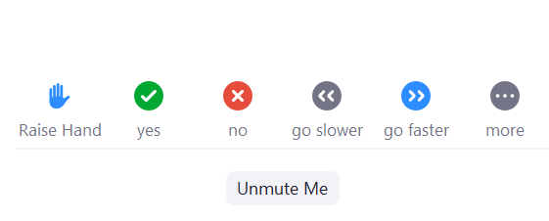
How do I ask questions?
Raise Hand
This will notify the host that you have a question and you can go ahead and unmute and ask
Chat
I’ll do my best to monitor the chat so that if you have any questions you can type them out and I’ll respond. Other students can answer too!
We will also use the other features as well!

Slide 11
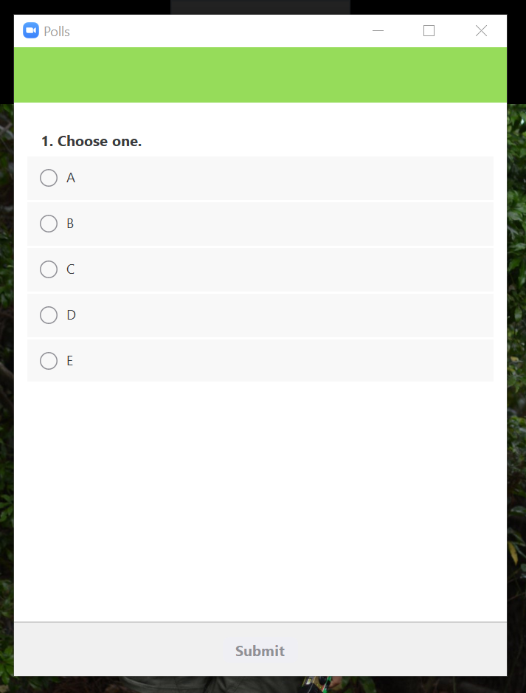
Knowledge Checks
Polling (like iClicker questions)
When a question is asked, the poll will pop up. You will then choose your answer and click submit.
Note: you cannot change your answer after you submit.

Slide 12
Let’s practice!
How was your summer break?
Amazing!
Caught up on sleep
Eh
What summer break?

Slide 13
Course Logistics

Slide 14
Getting Help from a Tutor
Submit a ticket to the autograder queue to request help during tutor hours: https://autograder.ucsd.edu/login
When a tutor accepts your ticket, join the zoom link in the ticket’s comments
Joining other students’ zoom meeting might be considered as academic integrity violation
Make sure to join the meeting within 2 minutes
Tips on online help:
We recommend joining with audio (computer or phone)
If you have technical difficulties, make sure to comment on the ticket to let the tutor know
If you share your screen with your code, make sure line numbers are visible. This will help the both of you to refer to points in the code
Sharing the entire desktop tends to be more reliable and is the best way to share your screen
If you are working in the lab, we recommend using your phone or bring headphones that have a mic

Slide 15
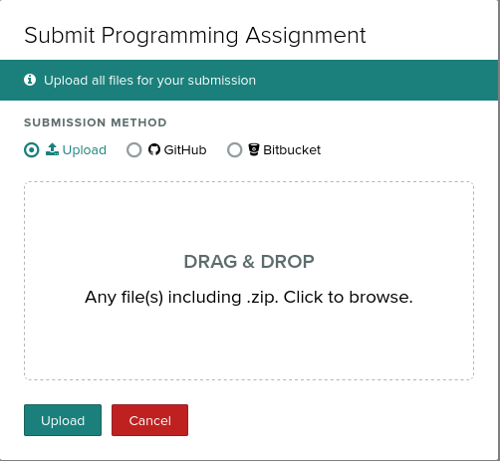
Submitting to Gradescope
Each programming assignment will have two separate Gradescope assignments to submit to i.e.
“Programming Assignment 1 - code”
“Programming Assignment 1 - questions”
The writeup will specify which files to upload. Only submit those files! You may encounter errors if you do not. We suggest using a zip file.
Once you submit, you will see the autograded results. If there is a compile error it will say so. Please read the error messages before seeking help from a tutor/TA

Slide 16
Questions?

Slide 17
Final Reminders
PA1 due Wednesday, October 14th @ 11:59 PM

